Slide 1
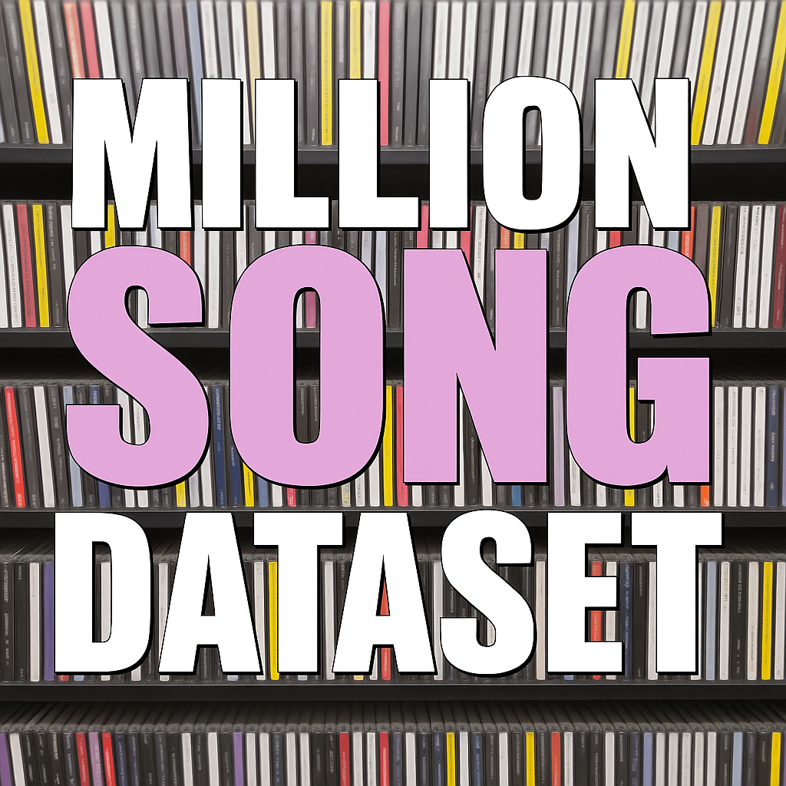

Big Data Analysis: Exploring the Million Song Dataset
Team: Hardy Hadoopers
Alec Pippas (awp251)
Bhavya Matam (bm3792)
Naman Vashishta (nv2375)
Saja Alsulami (sfa7673)
Zhuyuan Wang (zw4759)
Notes:
11

Slide 2
Agenda Overview
Introduction to the Million Song Dataset
Data Collection and Preprocessing
Exploratory Data Analysis (EDA)
Advanced Data Analysis Techniques
Results and Insights
Conclusion and Future Work
Notes:
We will begin with an introduction to big data and the Million Songs Dataset, outlining the project's objectives. Next, we will cover the data collection and preprocessing methods employed. Following that, we'll conduct exploratory data analysis, discuss advanced analytical techniques, and conclude with the results and potential future work.

Slide 3
Introduction to the Million Song Dataset and our Project
Notes:
Big data refers to large volumes of data that can be analyzed for insights. The Million Songs Dataset is a collection of audio features and metadata for a million songs, providing a rich resource for analysis in music data science.

Slide 4

Overview of the Million Songs Dataset (MSD)
MSD Overview
A 280 GB collection of metadata and audio features for one million popular music tracks from 1920-2010
Consists of text-based metadata and audio features and does not include raw audio bytes
Core Dataset Features
Each track includes over 50 fields including:
High-level Audio Features: danceability, energy, tempo, loudness, key, mode, duration, time_signature, year, etc.
Time-series musical structure: bars_start, beats_confidence, segments_pitches, segments_timbre, tatums_start, etc.
Metadata: artist_name, title, release, song_hotttness, track_id, artist_terms, etc.
Designed for Research and Development
The MSD dataset is designed for MIR (Music Information Retrieval) research, focusing on music analytics, providing a rich source of data for various Machine Learning applications.
Recommendation Systems
The Million Songs Dataset supports the building of recommendation systems which use unsupervised learning techniques like K-Means Clustering to enhance user experiences in music streaming services.
Notes:
The Million Songs Dataset contains various features such as song titles, artist information, and audio analysis. It serves as a comprehensive database for researchers and developers interested in music analytics and recommendation systems.

Slide 5

Purpose and Objectives of the Project
Exploring Musical Trends
The project aims to explore datasets to identify and analyze trends within the music industry.
Artist Popularity Insights
We will analyze artist popularity through various metrics, using data to uncover their rise in the industry.
Song Characteristics Examination
The project will investigate the characteristics of songs, such as genre, tempo, and lyrical content, to find patterns.
Predictive Data Analysis
Our objective includes using analysis techniques to predict future trends and artist success based on historical data.
Notes:
This project aims to explore the dataset to derive meaningful insights about musical trends, artist popularity, and song characteristics. The objective is to apply data analysis techniques to uncover patterns and make predictions.

Slide 6

Purpose of the Project
Music Recommendation
The project addresses music recommendation challenges by analyzing large-scale music data to suggest songs based on user preferences.
Playlist Curation
By using the Million Song Dataset, the project aims to improve playlist curation through clustering techniques to group similar songs.
Genre Classification
The project focuses on genre classification by analyzing musical features and implementing unsupervised learning and dimensionality reduction techniques.
Predicting Song Popularity
Regression techniques are used to predict the popularity of songs by analyzing patterns in the Million Song Dataset.
Notes:
This project addresses challenges in music recommendation, playlist curation, and genre classification. By analyzing large-scale music data using the Million Song Dataset (MSD), we aim to explore clustering to identify similar songs and regression to predict song popularity. Tools like Spark and techniques like unsupervised learning and dimensionality reduction are utilized to achieve these goals.

Slide 7
Project Objectives
Clustering Songs
We aim to cluster songs to reveal similarities between them, enabling a deeper understanding of musical patterns and connections.
Visualizing Similarities
We will create visual representations of the similarities between songs, making it easier to identify musical trends and relationships.
Analyzing Musical Trends
Our analysis will focus on musical trends derived from song features such as tempo, loudness, and genre, offering insights into the music data landscape.
Notes:
Our objectives include clustering songs to reveal similarities, visualizing these similarities, and analyzing musical trends from song features such as tempo, loudness, and genre. The MSD's comprehensive metadata and audio features provide a rich foundation for these analyses, supporting scalable and insightful exploration of the music data landscape.

Slide 8
Data Collection and Preprocessing
Notes:
Proper data collection and preprocessing are critical steps in data analysis. This section discusses the sources of the dataset, the cleaning process, and how we handle missing or inconsistent data.

Slide 9
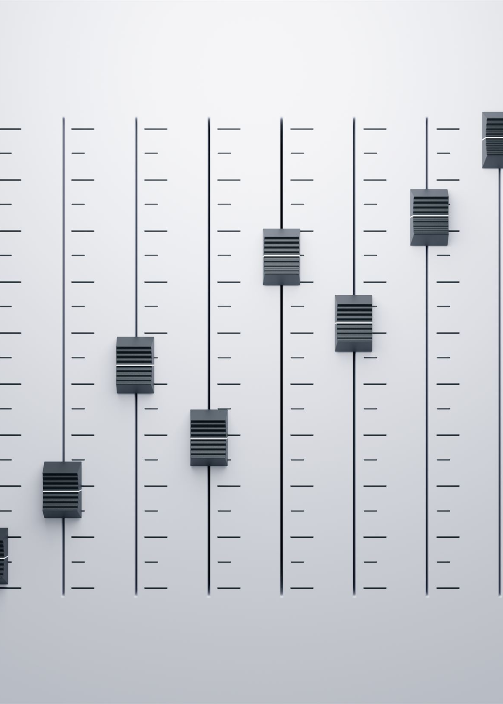
Sources of the Million Songs Dataset
Million Song Dataset Project
The Million Song Dataset project aims to provide a comprehensive set of music data for research and analysis.
Audio Features
The dataset includes audio features derived from music analysis tools, enabling deeper insights into song characteristics.
Music Metadata
Metadata from various music databases enriches the dataset, making it valuable for music-related research.
Notes:
The dataset was developed as part of the Million Song Dataset project, which provides access to various music data sources. It includes audio features derived from music analysis tools and metadata from music databases.

Slide 10
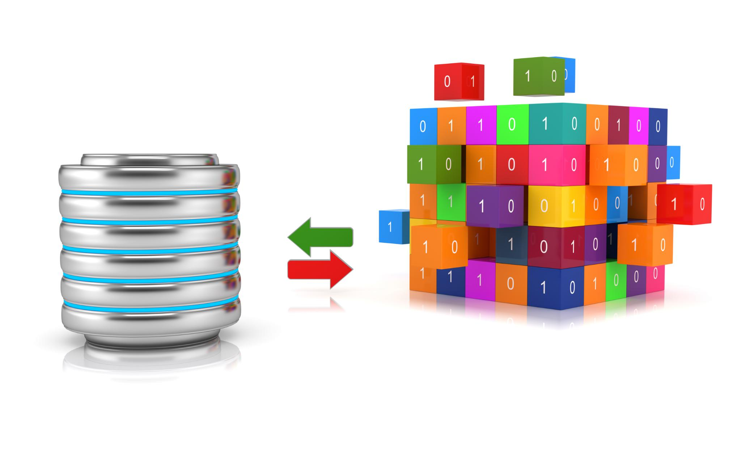
Data Cleaning and Preprocessing Techniques
Removing Duplicates
One of the first steps in data cleaning is identifying and removing duplicate entries to ensure data integrity.
Correcting Errors
Data cleaning involves correcting inaccuracies and errors in the dataset to improve data quality for analysis.
Normalization Techniques
Preprocessing often includes normalization, which scales numerical data to a standard range for better analysis.
Encoding Categorical Variables
Categorical variables need to be transformed into numerical formats through encoding for machine learning algorithms.
Notes:
Data cleaning involves removing duplicates, correcting errors, and ensuring consistency. Preprocessing may include normalization, encoding categorical variables, and transforming data to make it suitable for analysis.

Slide 11

Handling Missing and Inconsistent Data
Importance of Handling Missing Data
Accurate analysis relies on effectively managing missing data to avoid biased results.
Imputation Techniques
Imputation methods fill in missing values, allowing for a complete dataset and more reliable analysis.
Deletion Methods
In some cases, deleting rows or columns with missing data may be necessary to maintain dataset integrity.
Algorithms Handling Missing Values
Certain algorithms are designed to handle missing values directly, making them valuable for robust analysis.
Notes:
Handling missing data is crucial for accurate analysis. Techniques such as imputation, deletion, or using algorithms that can handle missing values are applied to ensure data integrity.

Slide 12
Exploratory Data Analysis (EDA)
Notes:
Exploratory Data Analysis is an essential step to summarize the main characteristics of the dataset. This section highlights techniques for visualizing and analyzing song attributes.

Slide 13
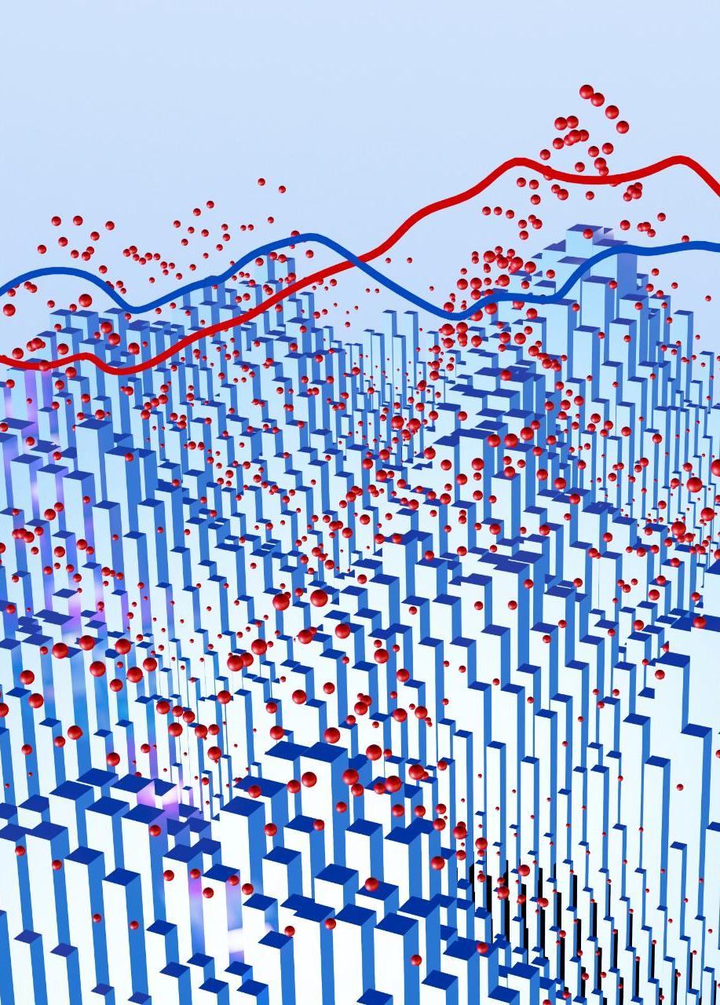
Descriptive Statistics and Data Visualization
Central Tendency
Central tendency measures the center of a dataset, indicating where the values tend to cluster. Common measures include mean, median, and mode.
Dispersion
Dispersion describes the spread of data points in a dataset, highlighting how much variation exists. Key measures include range, variance, and standard deviation.
Data Visualization Techniques
Visualization techniques such as histograms, box plots, and scatter plots facilitate better understanding of data distributions and relationships.
Notes:
Descriptive statistics provide insights into the central tendency, dispersion, and shape of the dataset's distribution. Visualization techniques such as histograms, box plots, and scatter plots help in understanding data distributions.

Slide 14
Analyzing Song Attributes (E.g., Tempo, Duration, Loudness)
Importance of Tempo
Tempo is a crucial musical attribute that affects the energy and feel of a song. It can influence listeners' emotional responses.
Duration Analysis
Duration refers to the length of a song, which can impact its popularity and appeal to different audiences.
Understanding Loudness
Loudness levels can significantly affect the listening experience and are often analyzed to understand trends in music production.
Notes:
Analyzing attributes such as tempo, duration, and loudness allows us to explore musical characteristics. This information can reveal trends in music styles and preferences over time.

Slide 15

Identifying Trends and Patterns in the Dataset
Trends in Music Genres
Analyzing the dataset reveals trends in the popularity of various music genres over different time periods. This insight is crucial for understanding audience preferences.
Shifts in Musical Style
The dataset allows us to observe shifts in musical styles, highlighting how artists innovate and adapt to changing tastes and cultural influences.
Insights for Stakeholders
Identifying these trends provides valuable insights for artists, labels, and industry stakeholders, helping them make informed decisions in their strategies.
Notes:
By examining the dataset, we can identify trends and patterns, such as the popularity of certain genres over time or shifts in musical style, providing valuable insights for artists and industry stakeholders.

Slide 16
Advanced Data Analysis Techniques: K-Means Clustering
Notes:
In this section, we will explore advanced techniques for analyzing the dataset, including clustering methods to categorize songs, predictive modeling to forecast trends, and dimensionality reduction for simplifying data complexity.

Slide 17
Clustering and Classification Methods
Clustering Algorithms
Clustering algorithms like K-means are effective in grouping similar songs based on various attributes, enhancing music organization.
Classification Methods
Classification techniques enable prediction of song categories or genres based on features, improving music recommendation systems.
Music Recommendation Systems
By utilizing clustering and classification, music recommendation systems can tailor suggestions to user preferences.
Notes:
Clustering algorithms such as K-means can be used to group similar songs based on attributes. Classification methods can predict song categories or genres based on their features, aiding in music recommendation systems.

Slide 18

Predictive Modeling and Regression Analysis
Predictive Modeling Techniques
Predictive modeling techniques enable us to forecast outcomes by analyzing relationships between input features and target variables.
Linear Regression
Linear regression is a widely used method for predicting trends based on the relationship between variables.
Applications in Trends
These models can be applied to various fields, such as predicting song popularity or other significant trends.
Notes:
Predictive modeling techniques, including linear regression, allow us to forecast outcomes based on input features. These models can help predict song popularity or other trends.

Slide 19
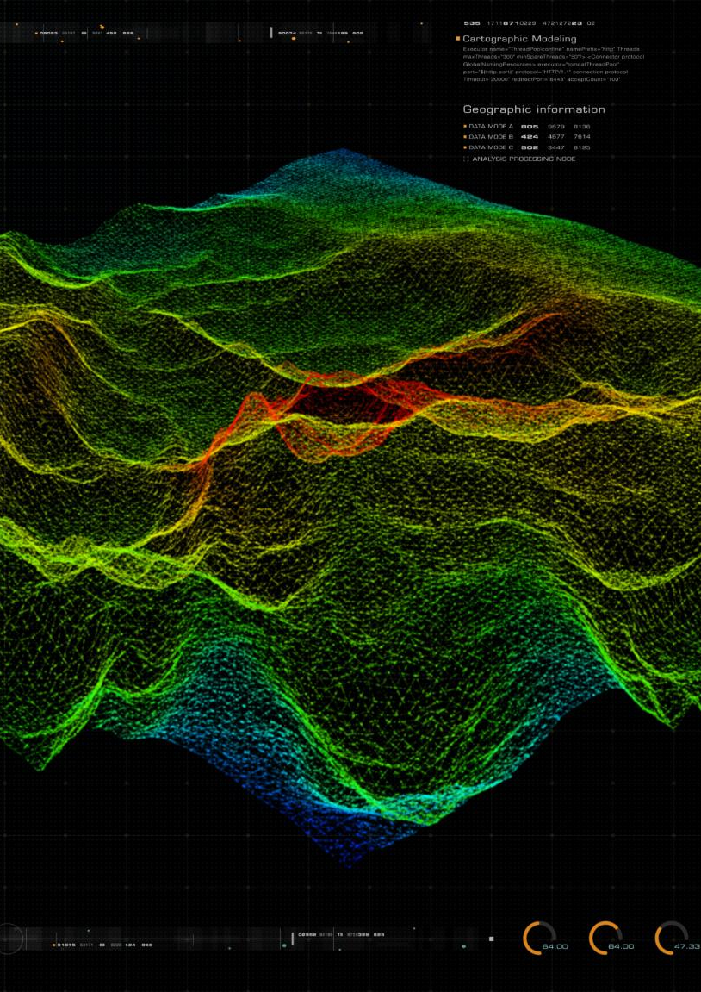
Dimensionality Reduction Techniques
What is Dimensionality Reduction?
Dimensionality reduction is a process that reduces the number of variables in a dataset while retaining its essential information.
Benefits of PCA
Principal Component Analysis (PCA) simplifies complex datasets, improves model performance, and enhances data visualization.
Improved Visualization
By reducing dimensions, data can be visualized more effectively, allowing for better insights and interpretations.
Notes:
Dimensionality reduction techniques such as PCA (Principal Component Analysis) simplify complex datasets by reducing the number of variables. This process enhances visualization and improves model performance.

Slide 20
Results and Insights
Notes:
In this section, we will discuss the key findings from our analysis, their implications for the music industry, and any limitations and challenges faced during the project.

Slide 21
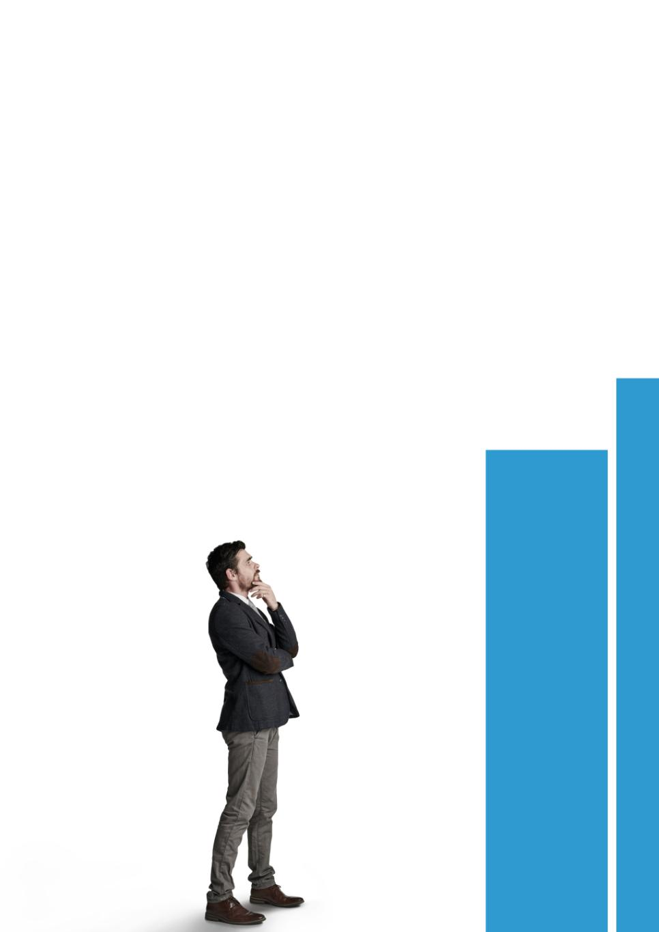
Key Findings From the Analysis
Trends in Music Preferences
The analysis highlighted significant trends in music preferences, showcasing shifts in what listeners enjoy over time.
Genre Popularity Shifts
Notable shifts in genre popularity were identified, indicating changing tastes among music listeners in recent years.
Song Attributes Correlation
The analysis found correlations between various song attributes and listener engagement, informing future music production.
Notes:
The analysis revealed significant trends in music preferences and characteristics. Key findings included notable shifts in genre popularity and correlations between song attributes and listener engagement.

Slide 22

Implications for the Music Industry
Informed Decision-Making
Producers and artists can utilize insights to make informed decisions regarding music production and marketing strategies.
Current Trends
Understanding current trends in music helps stakeholders adapt and thrive in the evolving music landscape.
Consumer Preferences
Insights into consumer preferences allow artists and marketers to tailor their efforts to meet audience demands.
Notes:
The insights gained from this analysis can inform music producers, marketers, and artists about current trends and consumer preferences, aiding in decision-making and strategy development.

Slide 23
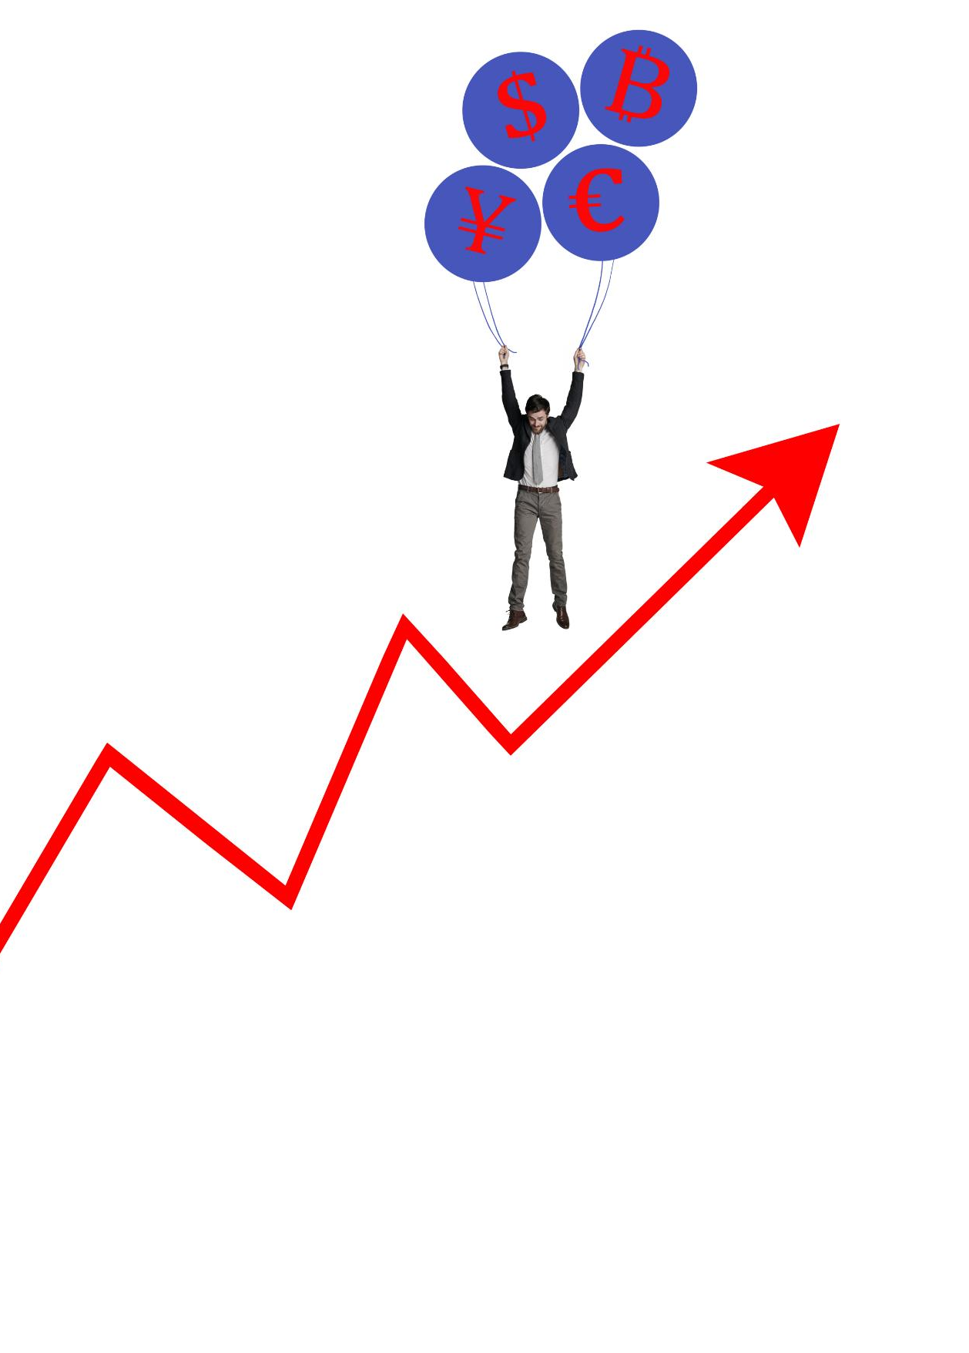
Limitations and Challenges Faced
Data Quality Issues
The analysis encountered significant data quality issues that affected the reliability of the insights obtained.
Computational Constraints
Computational limitations hindered the analysis process, affecting the speed and efficiency of data processing.
Future Research Considerations
Acknowledging these challenges is crucial for guiding future research and improving analysis methodologies.
Notes:
Despite the valuable insights, the analysis faced limitations such as data quality issues and computational constraints. These challenges must be acknowledged for future research and analysis.

